Slide 1

AI-Powered Job Scam Detection System
A Machine-Learning Classifier for Fraudulent Job Postings in Kenya
Moringa School — Data Science Capstone | Cohort DSF-FTH16M3
Dataset Research and Search — Whole Team
Melisa Achieng
Cleopas Karanja
Briannah Chelangat
Data Loading & Cleaning
Modelling
Backend, Job Seeker UI & Gov Dashboard Concept
Christopher Kariuki
Alex Kinyua
EDA & Project Documentation
Backend, Repository Admin & Deployment
Notes:
Title slide. Emphasize this is a capstone project with a real benchmark evaluation, not a deployed product. Team roles reflect division of labor across data, modelling, and (conceptual, not-yet-built) product/deployment work.

Slide 2

Problem Statement
Online recruitment has widened access to employment in Kenya — but also created new fraud vectors
Job seekers may encounter upfront-fee requests, vague job descriptions, urgency language, impersonated employers, or suspicious contact channels
External evidence: FTC-reported US job-scam losses rose from ~$90M (2020) to ~$501M (2024)
External evidence: a 2024 Kenyan DCI case reportedly affected ~1,000 job seekers
The practical gap: job seekers need a way to prioritize verification before engaging with a posting
A prioritization tool
Helping job seekers know what to verify first — not a substitute for official investigation or human judgment
External statistics: Commission, F.T. (2024), Federal Trade Commission; DCI (2025), Ministry of Interior and National Administration.
Notes:
Keep the framing careful: this is a decision-support / prioritization tool, not an enforcement or investigation system. The FTC figure is US-wide, not Kenya-specific — presented as external context, not a Kenyan statistic.

Slide 3




Proposed Solution
→
→
→
Posting Text + Metadata
Fraud-Risk Score
Explanation
Human Verification
Title, description, requirements, structured fields
Model-generated probability estimate
Influential words & structured signals
Job seeker / reviewer decides next step
The system supports human verification and official reporting channels — it does not replace them
Output is a fraud-risk score and classification (Legitimate / Fraud-risk) at a chosen operating threshold, not a certainty
Notes:
Emphasize the human-in-the-loop framing throughout: score → explanation → human verification, not score → automatic action.

Slide 4

Objectives & Success Criteria
Detect fraud-risk postings from text and structured metadata
Apply NLP — TF-IDF features with 1–2 word n-grams — to capture linguistic signals
Capture signals such as payment language, urgency, vague descriptions, missing fields, and suspicious contact patterns
Compare a text-only baseline against hybrid models combining text and engineered features
Select an operating threshold on validation data, balancing fraud-risk precision and recall
Produce explainable risk signals — not just an unexplained label — and prepare the model for a future web/API or human-review workflow
Notes:
The 'future accessibility' objective is intentionally phrased as future work — no USSD or WhatsApp integration has been built or tested.

Slide 5
Stakeholders & Intended Workflow
Primary Users
Kenyan job seekers, especially young adults
Beneficiaries
Distribution & Data Partners
Legitimate employers and agencies
Job boards and recruiters
Fraud-Risk
Screening System
Community Channels
Public-Sector Partners
County governments and TVET career services
NEA, Ministry of Labour, DCI, and related agencies
Notes:
Public-sector partners are grouped together (NEA, Ministry of Labour, DCI) — none of these integrations are implemented; they represent the intended long-term ecosystem.

Slide 6
Data Sources & Labeling Strategy
Source group | Approx. original size | Label status
Fake Job Postings / EMSCAD | 17,880 | Real benchmark labels
Fuzu Kenya | 666 | Unlabeled scraped postings
PigiaMe Kenya | 1,500 | Unlabeled scraped postings
Corporate Staffing Kenya | 3,988 | Unlabeled scraped postings
BrighterMonday Kenya | 1,964 | Unlabeled scraped postings
JobWeb Kenya | 5,323 | Unlabeled scraped postings
Synthetic Kenya-market augmentation | 40,000 (39,733 after cleaning) | Generated labels
71,321
−1,019
70,302
57,150 / 13,152
Initial combined records
Duplicates removed
Final integrated records
Labeled / Unlabeled records
Scraped Kenyan postings were not automatically labeled legitimate — they remain a separate, unlabeled contextual set.
Notes:
Row-count reconciliation, verified against the notebook: 71,321 raw → 1,019 duplicates removed (matched on title+company+location+description) → 70,302 final → split into 57,150 labeled and 13,152 unlabeled.

Slide 7
Dataset Structure & Target Definition
0 — Legitimate
0 = Legitimate
1 — Suspicious
1 = Fraud-risk
(Suspicious + Fraudulent)
2 — Fraudulent / Scam
Binary modeling target: Suspicious and Fraudulent/Scam are combined into a single Fraud-risk positive class.
Feature group | Examples
Text | title + description + requirements → TF-IDF, 1–2 n-grams, 50K-word vocabulary
Structured | company, location, industry, work type, salary range, experience level, qualification
Engineered | text lengths, word counts, URL/email/phone counts, uppercase-word count, missing-field flags
Label | is_fraud (0/1/2 source scheme) → binary Fraud-risk target for modeling
Notes:
The three-class-to-binary mapping was applied consistently across EMSCAD (harmonized from its native binary label) and the synthetic dataset (native 3-class).

Slide 8
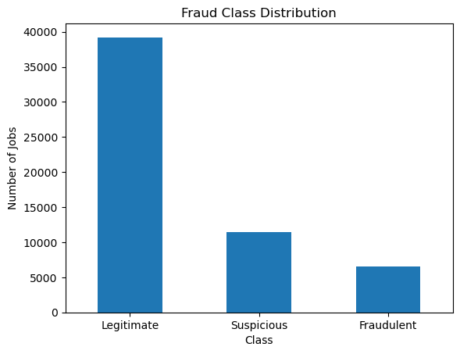
EDA Insight — Class Distribution
What it shows
Legitimate: 39,219 · Suspicious: 11,426 · Fraudulent: 6,505
Counts refer to the labeled subset only (57,150 of 70,302 records)
This imbalance is why precision, recall, F1, and PR-AUC are more informative here than raw accuracy
Source/data note: notebook EDA output (labeled_df class distribution).

Slide 9
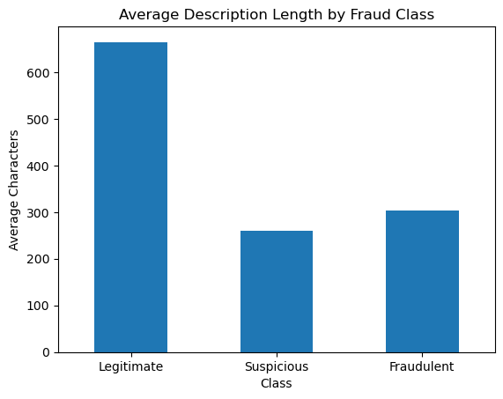
EDA Insight — Description Length
What it shows
Legitimate postings average longer descriptions than Suspicious or Fraudulent ones in this dataset
Presented as a dataset pattern, not a universal fraud rule
Description length was carried forward as one engineered feature for modeling
Source/data note: notebook EDA output (average description length by class).

Slide 10


Methodology & Evaluation Design
→
→
→
Isolate Holdout
Train/Validation Pool
Tune Models
Threshold & Holdout Eval
20% of real EMSCAD records set aside untouched
Remaining EMSCAD + synthetic labels: 53,666 records
TF-IDF + engineered features; GridSearchCV, 5-fold, average precision
Validation threshold selection, then one-time holdout evaluation
Baseline: Logistic Regression on TF-IDF text only • Hybrid candidates: Logistic Regression and LinearSVC on TF-IDF + structured features
Class imbalance handled with class_weight="balanced"; tuning optimizes average precision (PR-AUC) via 5-fold GridSearchCV
Training split: 42,932 records • Validation split: 10,734 records • Real holdout: 3,484 records (kept fully separate)
Notes:
The real EMSCAD holdout (3,484 records: 3,314 Legitimate, 170 Fraud-risk) is the primary final estimate of performance — it is never used for fitting, tuning, or threshold selection.

Slide 11
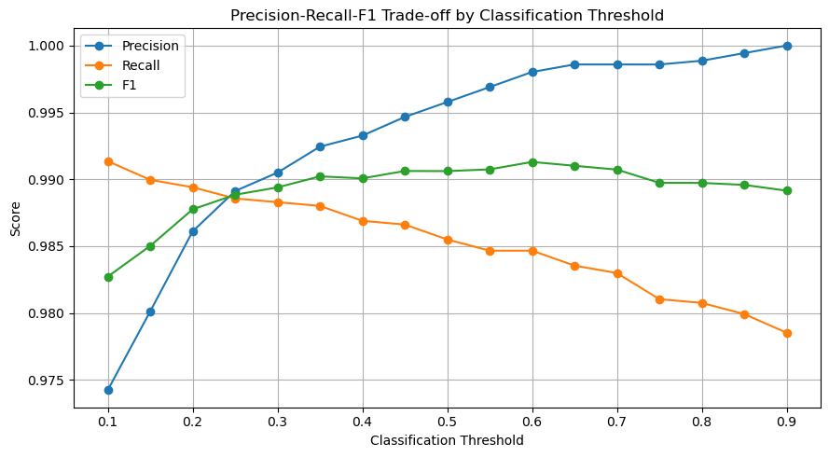
Modeling Insight — Threshold Selection
What it shows
Threshold candidates were evaluated on validation data only
0.6047 maximized validation F1 (0.9913)
The real holdout was not used to choose this threshold
Not claimed to be a universal or permanently optimal threshold
Source/data note: notebook threshold-sweep output (validation set).

Slide 12
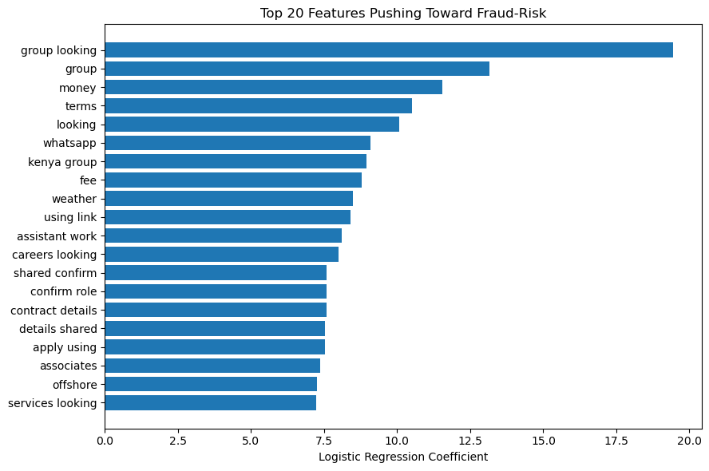
Modeling Insight — Explainable Fraud-Risk Signals
What it shows
Strongest positive coefficients include terms like "fee", "money", "whatsapp", and "confirm role"
These are dataset-specific associations that increase the model's fraud-risk score
Not universal or causal fraud rules — they support human review, not replace it
Source/data note: notebook Logistic Regression coefficient output.

Slide 13
Final Evaluation & Limitations
Real EMSCAD holdout — measured results (left) vs. known limitations (right)
Measured Results
Limitations
Fraud-risk precision
99%
Training data is synthetic-heavy
Kenyan scraped postings lack ground-truth labels
Real Kenyan-market generalization is not yet established
Registry and blacklist checks are future work, not implemented
Deployment is planned, not completed
Fraud-risk recall
92%
Fraud-risk F1
96%
ROC-AUC
0.9947
PR-AUC
0.9768
False positives
1 legitimate posting flagged
False negatives
13 fraud-risk postings missed
Notes:
Results are from the real EMSCAD benchmark holdout, not confirmed Kenyan job-board scam cases. Kenyan-market generalization remains unverified because the scraped Kenyan postings have no ground-truth fraud labels.

Slide 14

Conclusion & Recommendations
The tuned hybrid Logistic Regression provides a promising fraud-risk ranking and classification workflow on the real EMSCAD benchmark holdout.
Collect and manually label Kenyan job postings to build real ground truth
Validate red-flag patterns against confirmed local scam cases
Add registry and blacklist verification as a separate, clearly-labeled verification layer
Pilot human-in-the-loop review with a job board or public-sector partner
Monitor drift and reassess the operating threshold over time
Notes:
Avoid presenting the system as ready for fully automated enforcement — it is a decision-support tool validated on a benchmark, not yet on confirmed Kenyan cases.

Slide 15
Thank You
Questions welcome
“The goal is not to replace human verification—it is to help people know what to verify first.”
AI-Powered Job Scam Detection System | Moringa School Data Science Capstone

